Slide 1
Recent reductions in aerosol emissions have increased Earth’s energy imbalance
Name Name, CICERO
27.06.24, Oslo
xxxx.xxxx@cicero.oslo.no

Slide 2
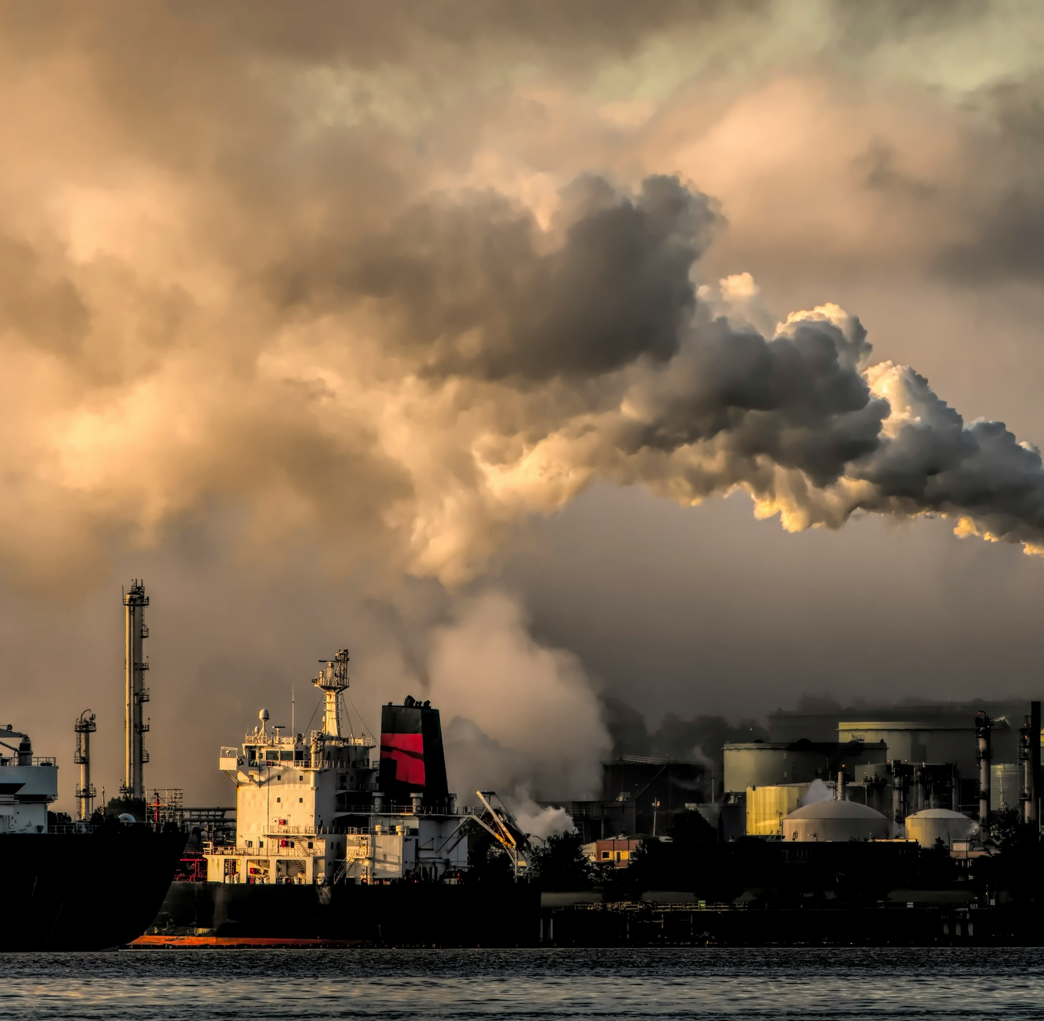

Recent reductions in aerosol emissions have increased Earth’s energy imbalance
Name name, cicero
21.06.25, Oslo
xxx.xxx@cicero.oslo.no

Slide 4
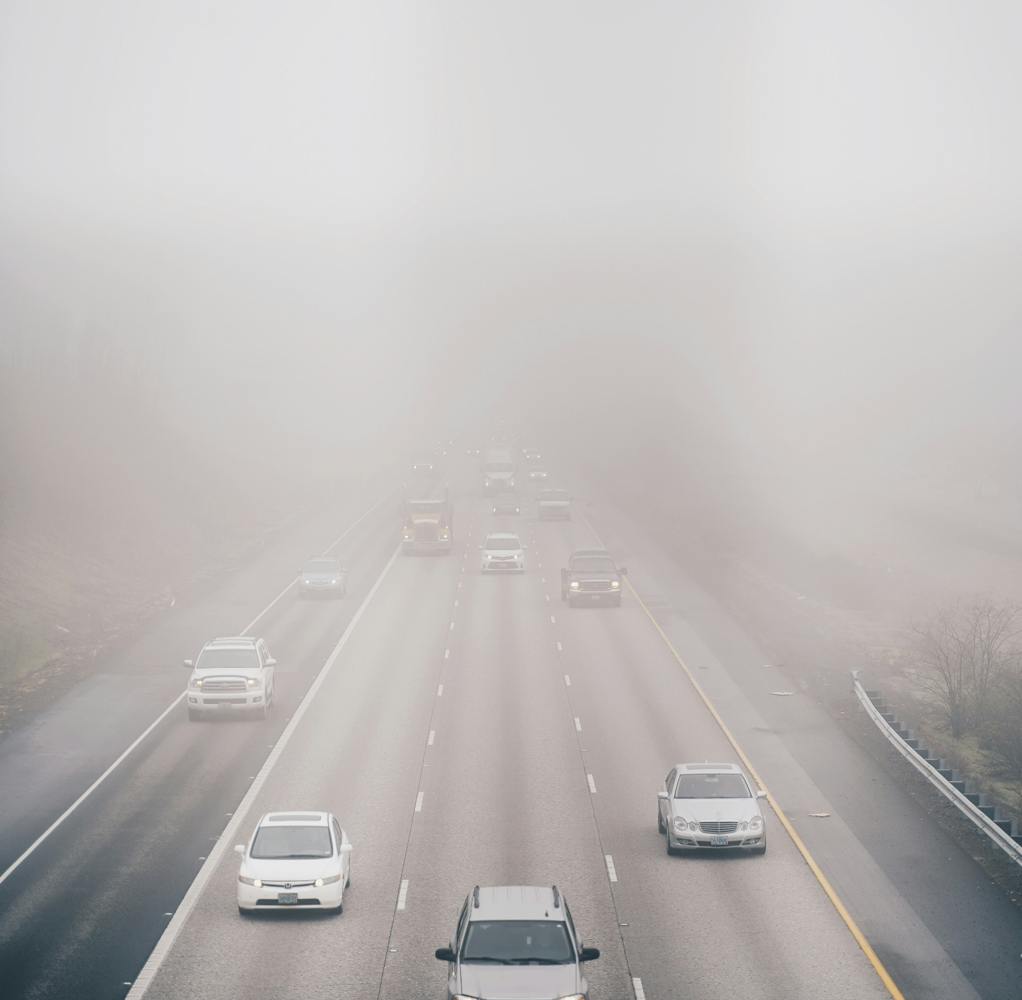

Recent reductions in aerosol emissions have increased Earth’s energy imbalance
Name name, cicero
21.06.25, Oslo
xxx.xxx@cicero.oslo.no

Slide 5
Here we go
Jhher
Kjklj
Fafdsf
sdafdasf

